Slide 1
Automatic Pet Food Dispenser
Group 25
Nick
Nabors
Bao
Nguyen
Mehrob Farhangmehr
Hamid Igliou

Slide 2
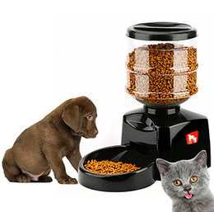
Project Overview
Automatic pet food dispenser
Remotely controlled through a mobile phone
Worry free to pet owners when away from home
Food portion control
Ability to schedule dispensing times
Self-contained device
Notes:
Mehrob

Slide 3
Goals and Objectives
Design and build the automatic pet feeder
Design project layout and schematics
Hardware and software communication
Power supply and control board
Give the pet owner control
Notes:
Mehrob

Slide 4
Requirements and Specifications
Wireless Control | Connection up to 30 ft
Dimensions | Smaller than 2’ x 2’ x 2’
Power Consumption | 5V - 12V, 1 - 3W
* Low Food Reminder | Reminder when food is at low threshold
* Manual Dispensing | Dispenses food within 30 seconds of command
* Setting Timer | Dispenses food within 60 seconds of set time
Weight | 2 - 3 Lbs without food
Container Size | Should hold 1 Lb of food
Legend
* - Are going to be Tested during presentation
Notes:
Bao

Slide 5
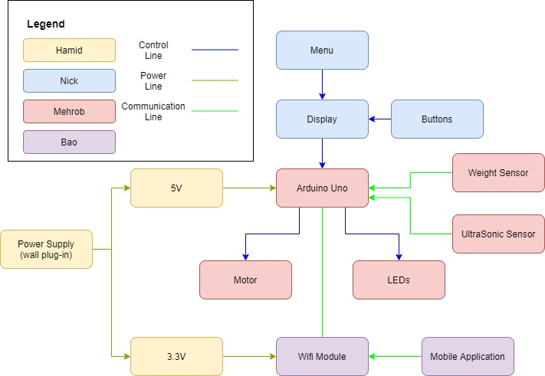
Block Diagram
Notes:
No more LED and weight sensor, so remove?

Slide 6
Overall System Design

Slide 7
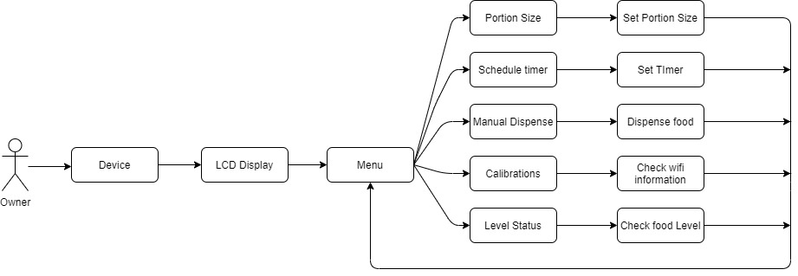
Overall System Design
Notes:
Nick

Slide 8
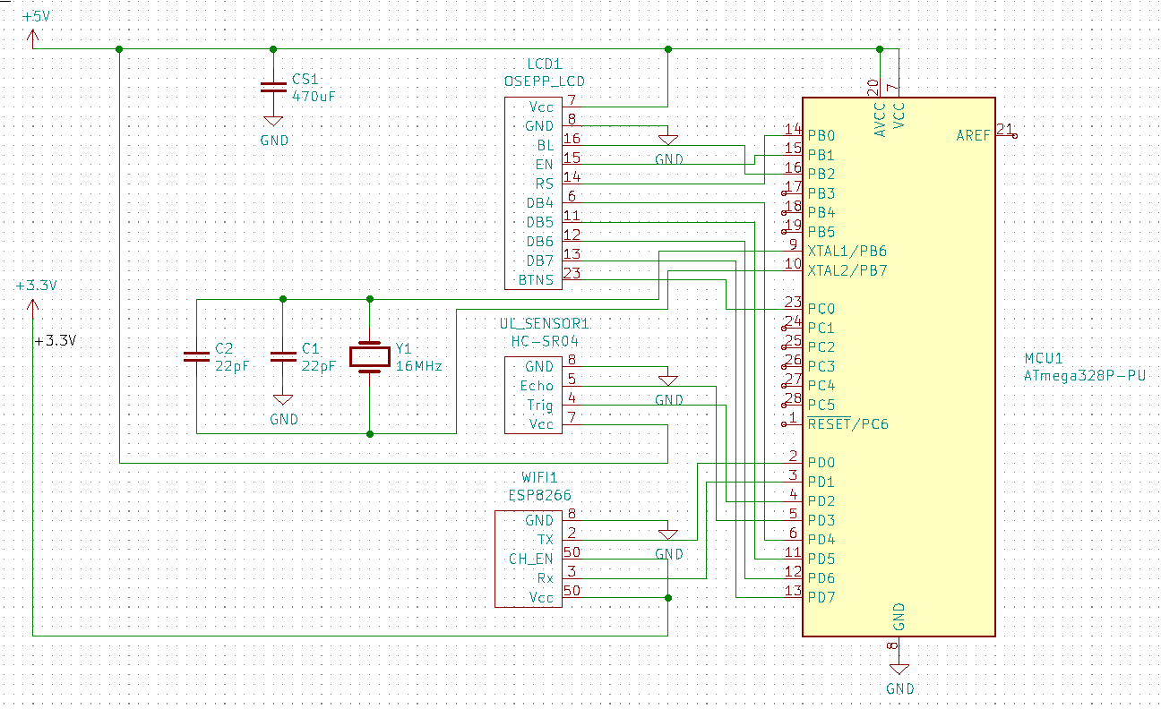
Overall Schematic
Notes:
Nick

Slide 9
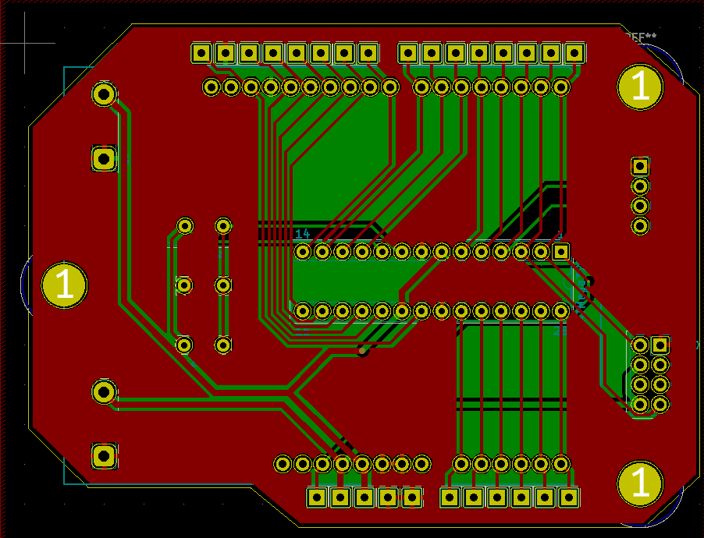
PCB
Incorporates pin connections for all sensors
Includes power connections
Small, compact design
Power supply distanced from main components for thermal protection
Two layer PCB, Red being the top layer and Green being the bottom layer
Notes:
Nick

Slide 10
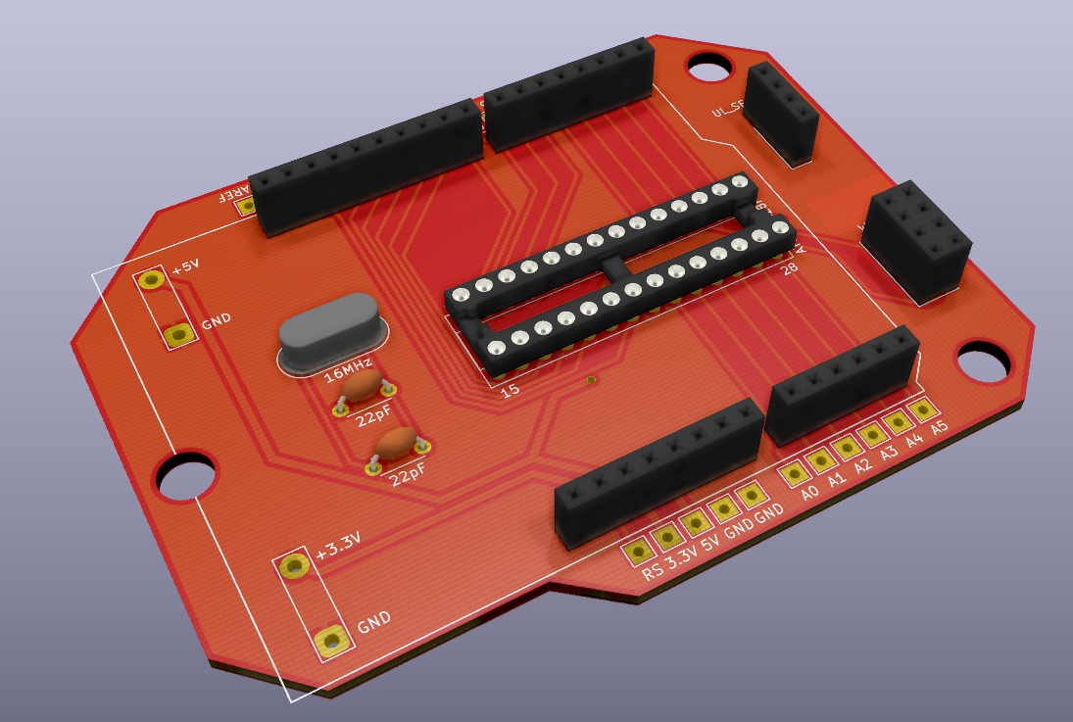
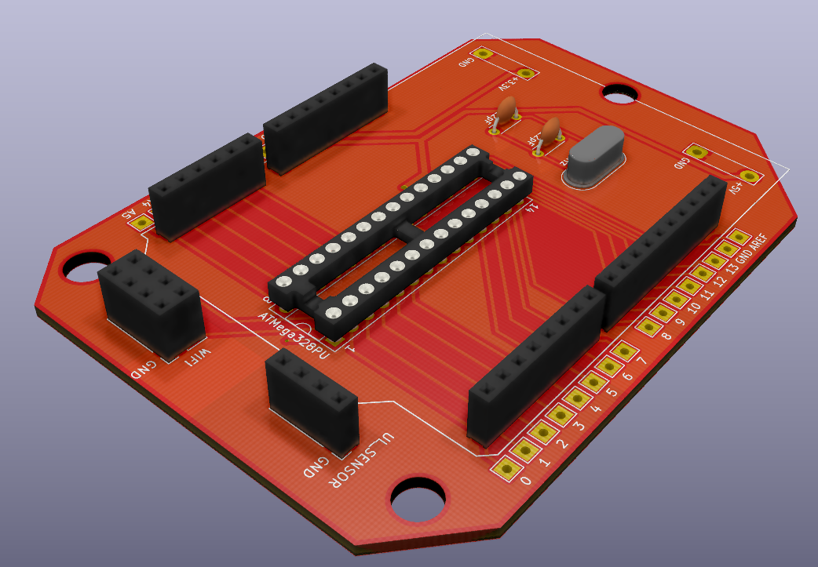
PCB (cont.)
Long pin connectors match Arduino Uno shield for LCD mounting on top
KiCad provides 3D render of PCB design and components for better visualization and design
Can be easily placed into housing of the food dispensing design
Notes:
Nick

Slide 11
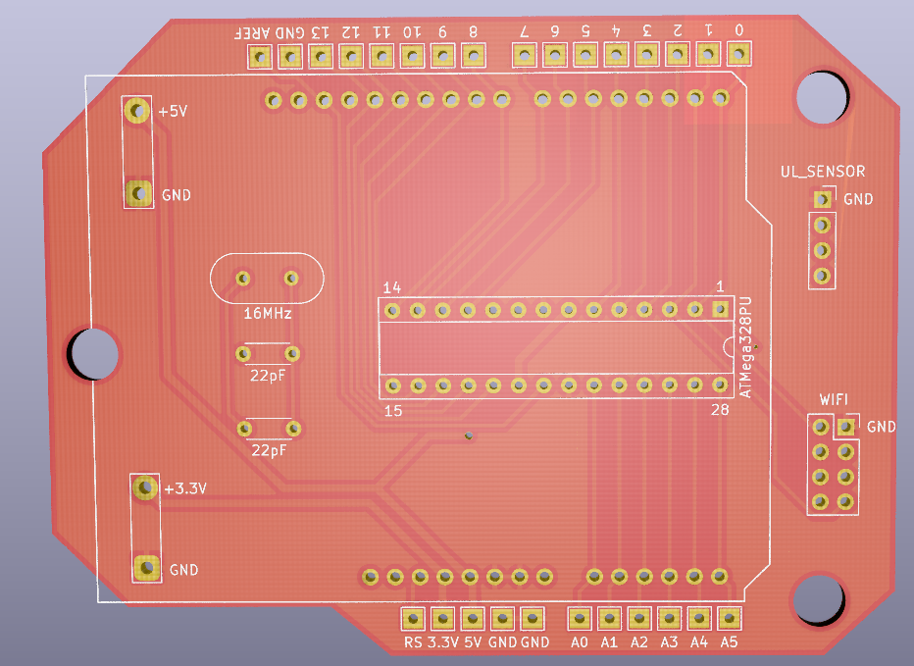
PCB (cont.)
PCB arrived as imaged on the left
Through-hole components were used in the final design to be hand soldered
Easier than surface mount
Easy to identify necessary components
Notes:
Nick

Slide 12
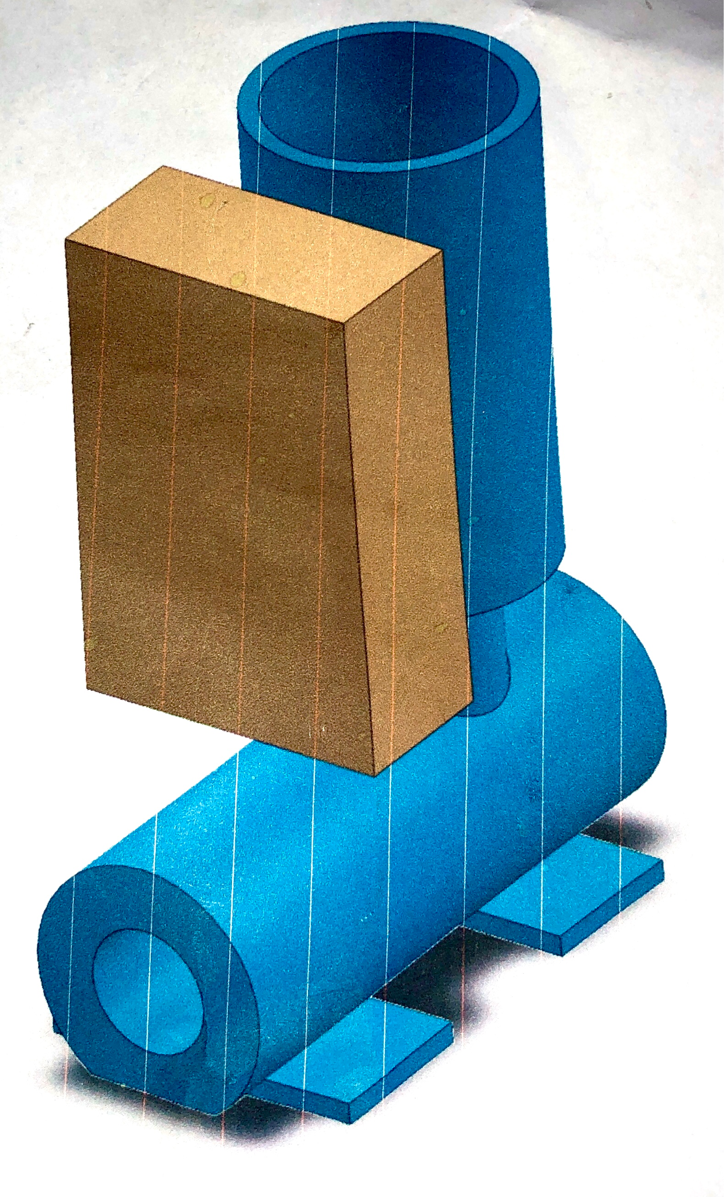
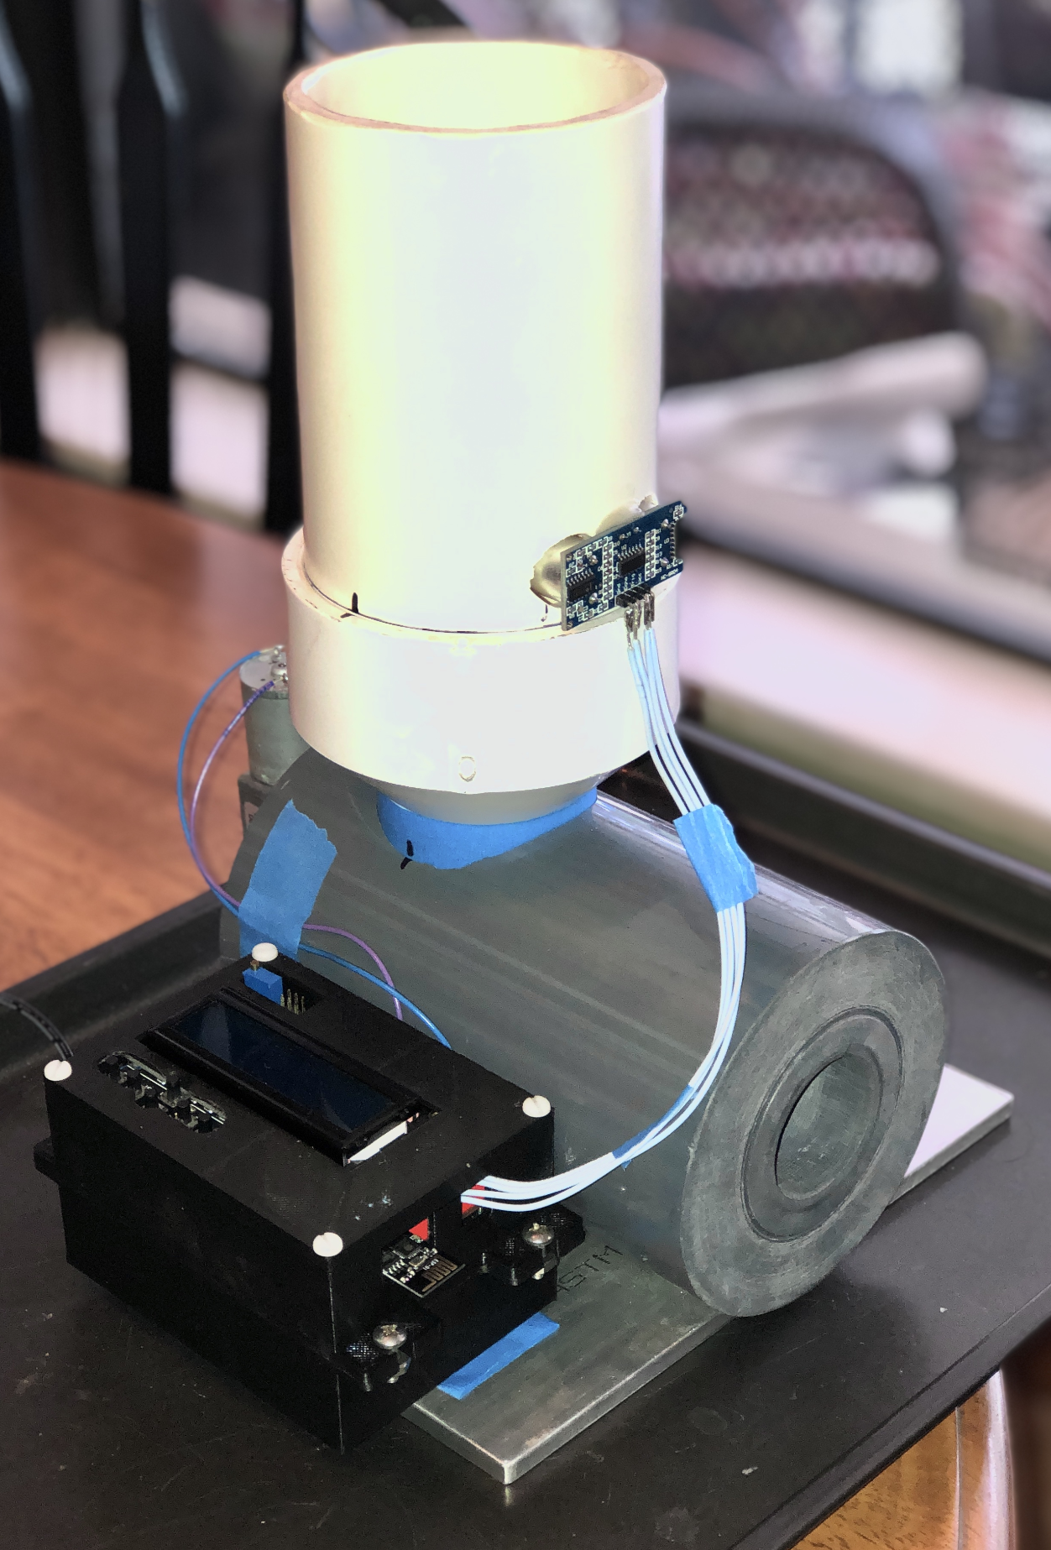
Physical Design
The drawing to the right is the initial physical design that is mostly the same design
The electronics housing was moved to the side for easier mounting and debugging purposes

Slide 13
Hardware Components

Slide 14
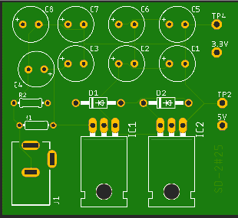
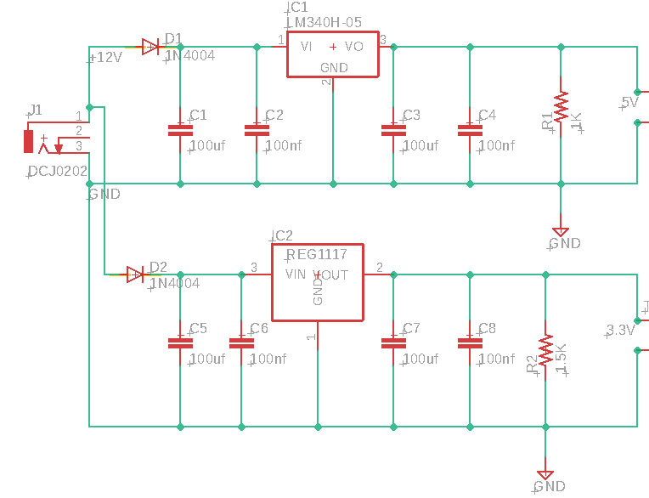
Power supply
Notes:
Hamid

Slide 15
REG1117
Notes:
Hamid

Slide 16
Voltage Regulators
Availability
Readily available in the market
Current Limiting Feature
In the event of a short circuit, the regulator has an internal current limit to protect it from damage.
Thermal overload protection
The internal thermal shutdown provides safe operation area protection. If the junction temperature is allowed to rise to 150°C, the device will go into thermal shutdown.
Notes:
Hamid

Slide 17
Microcontroller
The Microcontroller, or MSU, is the most important part of the project, bringing every component together.
The requirements for the MSU in this project is:
Able to read external peripherals such as sensors and buttons
Ease of programming
Output 5V and 3.3V
Low price
Notes:
Mehrob

Slide 18
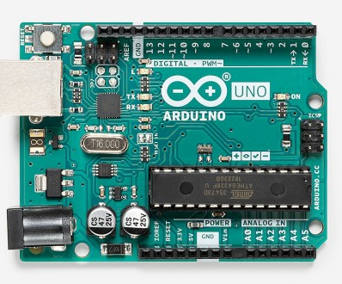
Arduino Uno
The Arduino Uno meets the minimum requirements for this project and provides more benefits.
Due to the popularity of the Arduino, there are many manufacturers for different parts
Arduino is coded in C++. The chip used is the Atmega328P.
Arduino Uno outputs 5V and 3.3V required for the project.
The Arduino itself is $20 with parts such as wires, sensors, and LCD being under $10
Notes:
Mehrob

Slide 19
Distance Sensor Comparison
Sensor | Detection | Distance | Price | Example
Ultrasonic | Ultrasonic waves | Small (~10m) | $1 | HC-SR04 ultrasonic sensor
Radar | Radio Waves | Large(>200m) | $10 | Grove - AHT20 I2C
LiDar | Light Waves | Small or Large | $40 | TF Mini LiDAR ToF (Time of Flight) Distance Sensor
IR | Light Waves | Small (~8m) | $15 | Grove - 80cm Infrared Proximity Sensor

Slide 20
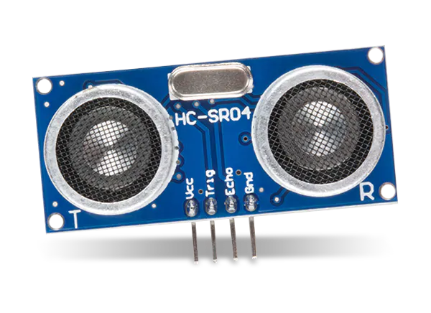
Sensors
Uses 1 main sensors for detection:
UltraSonic Sensor - Checks the contents of the container to see if it’s running low or empty.
Whether or not the container has food is sent to the MSU
The MSU updates to data to display it on LCD or Mobile APP
Notes:
Mehrob
Make note of no longer needing weight sensor?

Slide 21
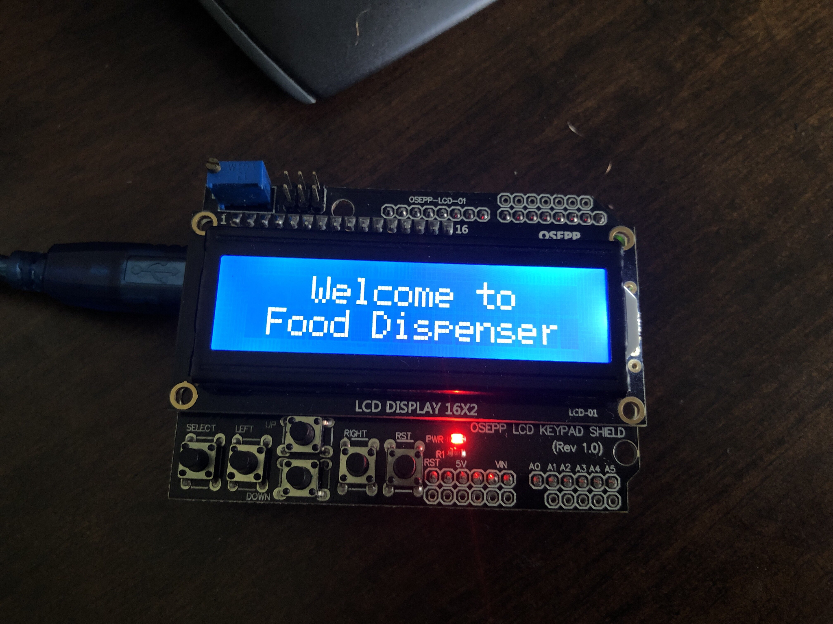
LCD
The LCD Menu controls and displays various fields as shown in the Overall System Design slide
The OSEPP 16x2 Display includes button control and pin interfacing with the Arduino Uno board, as shown in the images
Chosen for admirable price, $15, and its libraries and easy integration with the Arduino Uno board
Compared to other similar parts, solid design and library support leading to this choice
Notes:
Nick

Slide 22
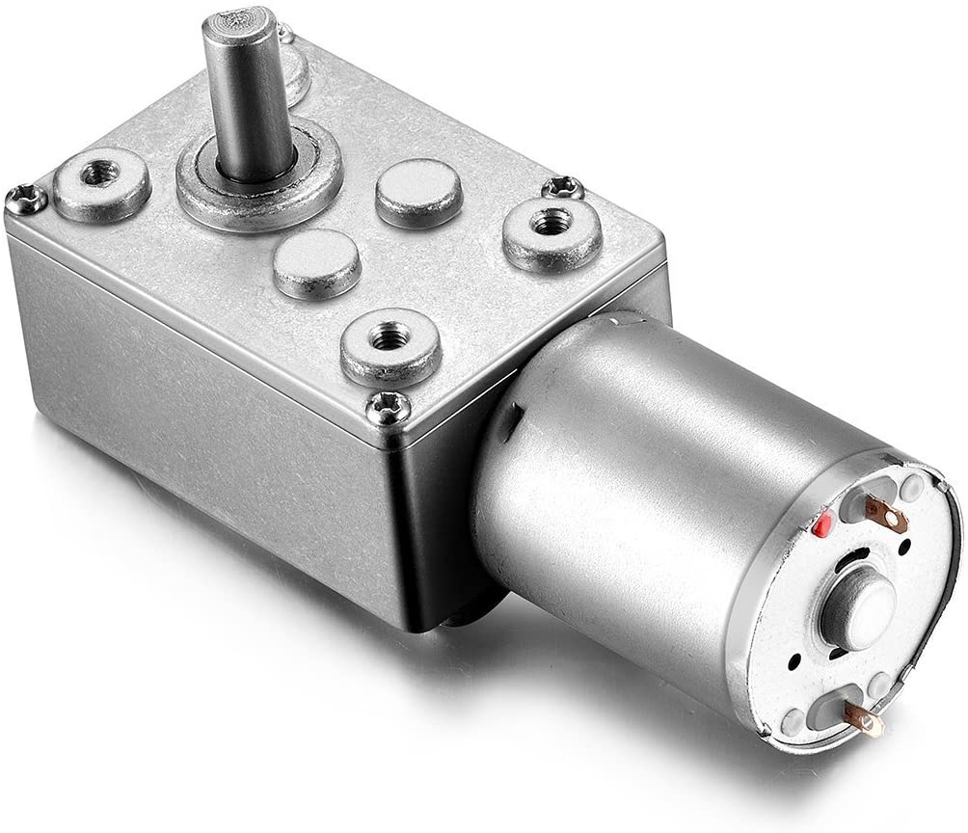
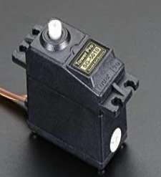
Motor Comparison
Name | Power | Torque | Material | Degree | Price
Uxcell 5V 9RPM DC Gear motor | 5V | 1.6 Kg/cm | Metal | 360 | $15
Metal Gear Digital RC Servo Motor | 5V | 12 Kg/cm | Metal | 180 | $12
Adafruit Micro Servo | 5V | 3.5 Kg/cm | Metal | 180 | $12
Adafruit MG90D | 5V | 2.1 Kg/cm | Metal | 90 | $10

Slide 23
Motor
The motor is responsible for turning the dispensing unit
For this project, that is the corkscrew
The motor for this project is Uxcell 5V 9RPM DC Gear motor
Uses 5V to be powered and has a 9RPM rated torque
Costs $15 and is made of metal

Slide 24
Wifi Mobile
Technology Comparison
Type | Range | Speed
Bluetooth | ~33ft | 1 - 3 Mbit/s
Zigbee | ~100ft | 250 Kbit/s
Wifi | ~150tf | 3 - 8 Mbit/s
Technology Selection: Wifi

Slide 25
WiFi Mobile (cont.)
Part | Capabilities |  |  |  |  |  |  |  |  | Cost
 | I2C | SPI | UART | TCP | UDP | HTTP | BLE | BT | BT4.2
MKR1000 | x | x | x |  |  |  |  |  |  | $34.99
MKR1010 | x | x | x |  |  |  | x | x |  | $32.10
ESP8266 |  |  |  | x | x | x |  |  |  | $3.98
ESP32 |  |  |  | x | x | x | x | x | x | $10.00
Arduino Uno w/ Wifi |  |  |  | x |  |  |  | x |  | $45.00
Notes:
Bao

Slide 26
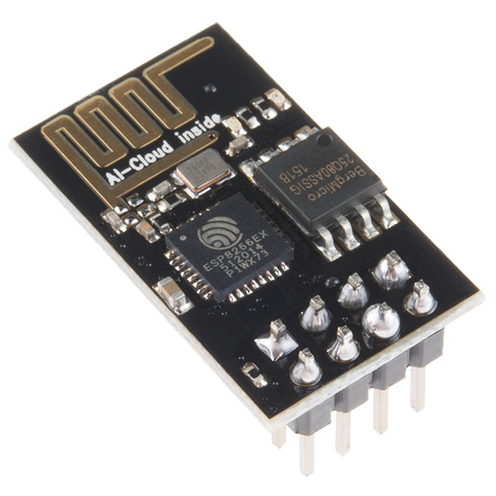
Wifi Mobile (cont.)
Part Selection: ESP8266
Part Cost: $3.98
This part is used to allow connection to feeder through wifi
Essential for remote access and control of device
Also Needed for Notifications
Notes:
Bao

Slide 27
Software Components

Slide 28
Microcontroller Software
Arduino IDE using C/C++
Compiled and uploaded to Arduino Uno Atmega328P microcontroller
Simple, easy to use
Large source of libraries and support
Easy to program multiple components and sensors
Image on right shows startup source code for LCD and the Menu
Notes:
Bao

Slide 29
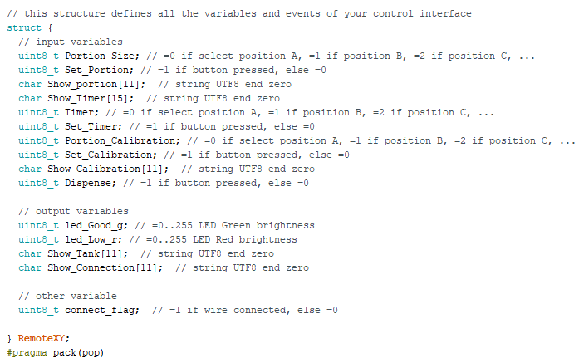
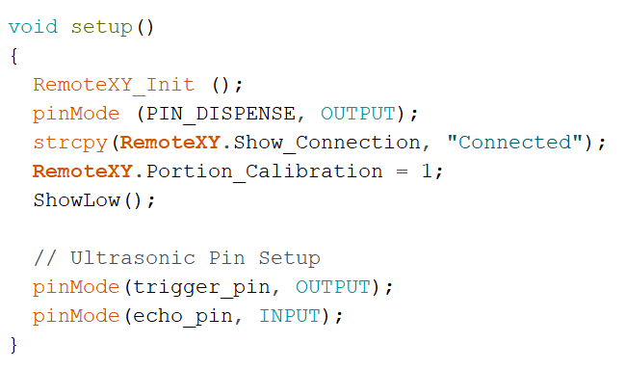
Mobile Application
Platform: RemoteXY
Language: C++
Reasons:
Complications with Wifi module
Allowed access point control
Large library for connection
Easy UI creation
Notes:
Bao

Slide 30
User Interface

Slide 31
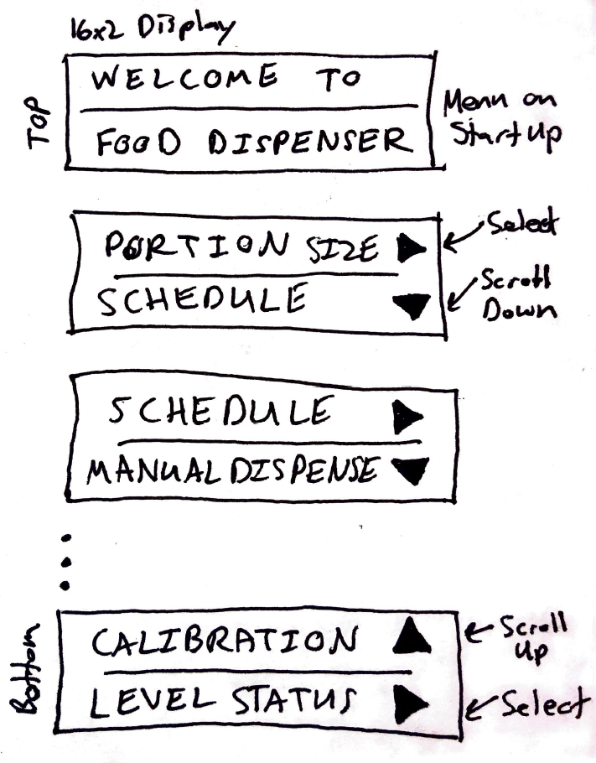
User Interface and Control (cont.)
General Breakdown:
LCD Display/Menu
User Controlled
Selection of portion size: 1/3 Cups to 3 Cups (range of dispensing)
Scheduling of dispensing
Dispensing of food manually
Vitals
Status of food level in tank (checked after dispensing)
Portion calibration
Wifi connection status
Power level
Button Control
Up/Down buttons to scroll menu
Select button to select menu option
Notes:
Nick

Slide 32
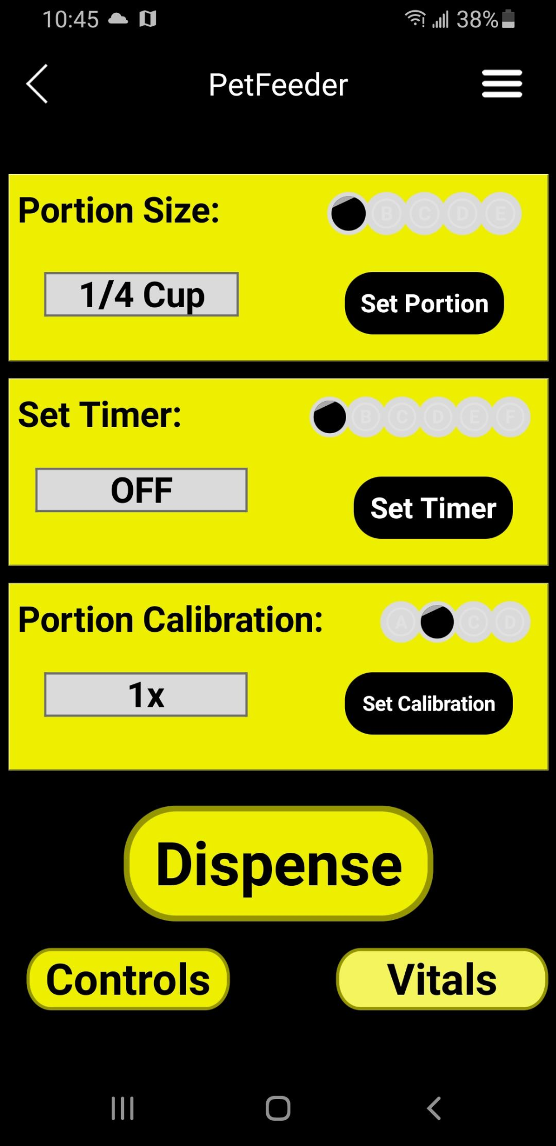
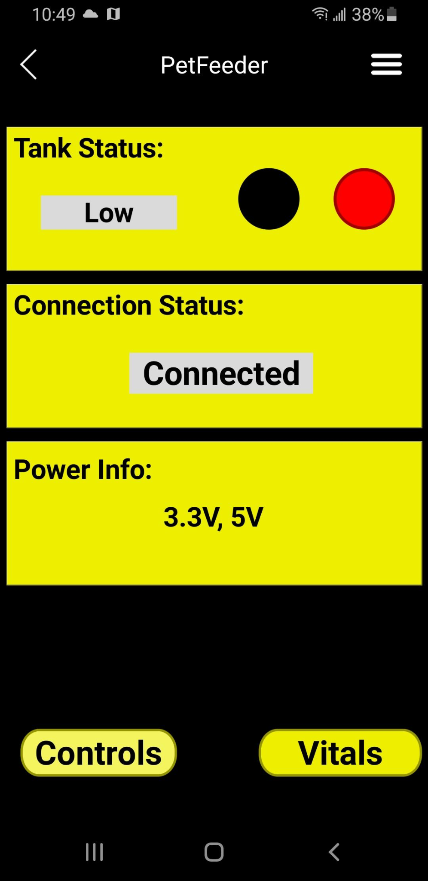
Mobile Application User Interface
Controls Page (Left):
Set portion size
Set timer
Set portion calibration
Manually dispense
Vitals Page (Right):
See tank Status
See connection status
Power info

Slide 33
Administration

Slide 34
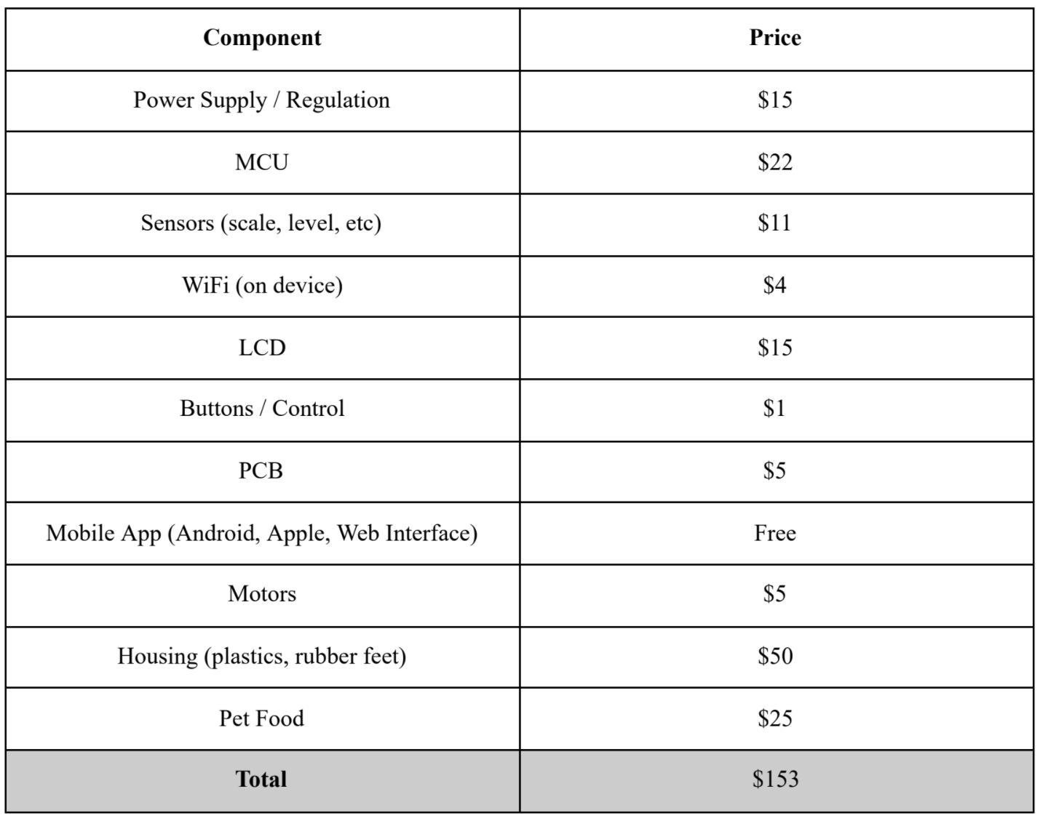
Budget
Non-sponsored project, had to try to keep budget low
Estimated Budget: $250
We are well below our estimated budget
Notes:
Bao

Slide 35
Roles
Group Member | Role
Nick Nabors | LCD, User Interface, Menu Navigation MCU PCB Sensor and Motor Control/Functions Physical Design, 3D Printing and Build/Assembly Electromechanical Integration/Testing
Hamid Igliou | Power supply
Bao Nguyen | Mobile application development/Design Mobile application unit testing Wifi module selection/Development MCU/Software Debugging
Mehrob Farhangmehr | Sensor testing and research Microcontroller testing and research Mobile App design help

Slide 36
Specification Test Results
Tests were successful
Design was able to completely demonstrate and dispense the three main desired specifications
More features were successful as well
Manual Dispensing dispensed within 1-2 seconds which is within 30 seconds of our initial specification
Schedule timer was successful and worked within the 60 second but varied on start time within the 60 seconds depending on the menu option
Low food reminder worked as expected and displayed, correctly, the status of the tank up to the design specifications

Slide 37
Project Challenges
MCU memory not large enough for LCD menu and Wifi module code/variables
Chip shortage caused issues with receiving items
Could not integrate Wifi module into PCB due to chips not being sold separately
Change of motor as initial motor had 270 degrees of rotation and low torque
With new motor came new power changes to power supply to account for spikes in voltage and power consumption

Slide 38
Questions?

